Slide 1

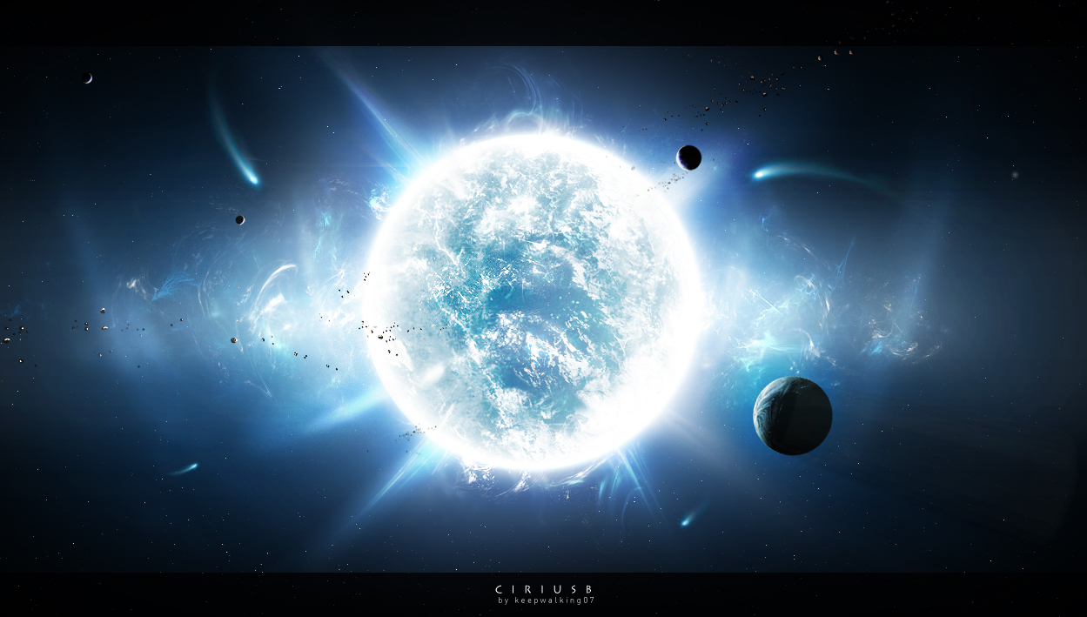
Discovering
Stellar
Secrets

Slide 2
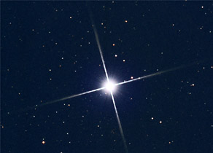
Sirius Through the Telescope
Sirius is a huge blue star 8 light years away. It is one of the closest stars to our Solar System.

Slide 3
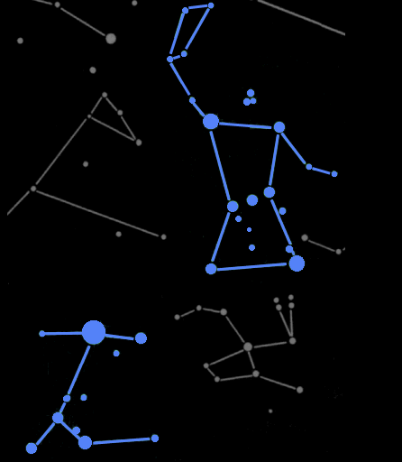
Sirius marks the head of Canis Major, the Great Dog (one of Orion's two hunting dogs).
Orion
Sirius is the brightest star in the night sky.
Canis Major

Slide 4
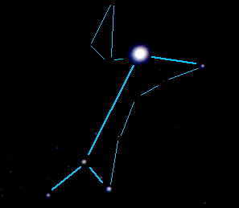
Sirius in Canis Major
This is a photograph of Canis Major with the constellation drawn in. You can see just how bright Sirius is, compared to the other stars.

Slide 5
Stars and their Spectra
The light from a star can be split up into its component colors to form a spectrum.
A star's spectrum is crossed by numerous dark lines. The positions and strengths of these spectral lines defines a star's spectral type.

Slide 6
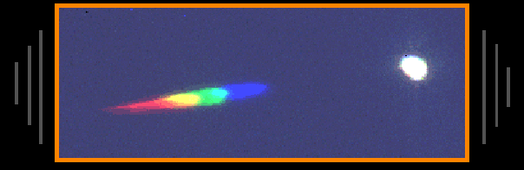
Sirius's Spectrum
On the right is the image of Sirius through the telescope – it looks like a white spot.
On the left is the light from Sirius spread out into its component parts –its spectrum.

Slide 7
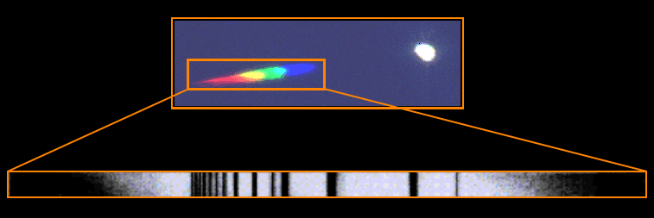
Sirius's Spectrum in Detail
When the light from Sirius is fully spread out, dark lines become clear.
These lines are gaps, where light from the star has been absorbed by gasses in the star's atmosphere.

Slide 8
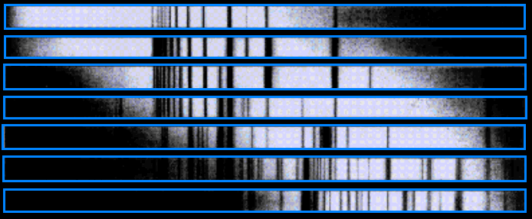
The Spectra of Stars
Spectra from different stars
hot
stars
cool
stars
Stars with different temperatures have absorption lines at different locations in their spectra.

Slide 9
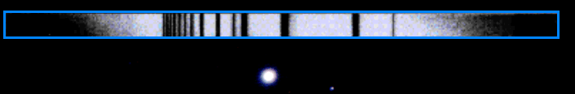
The Spectrum of Sirius
Sirius shows the spectrum of an "A type" star.
It is 1.8 times hotter and 21 times more luminous than our Sun, which is a "G type" star.

Slide 10
Stars and their Spectra
Astronomers use spectrographs similar to this one to observe dark lines in the spectra of stars which tells them what elements the star is made of and their relative abundances.

Slide 11
Stars and their Spectra
The foundation of our understanding of the information hidden in a stars’ spectrum goes back to the work done by the women at the Harvard College Observatory.

Slide 12
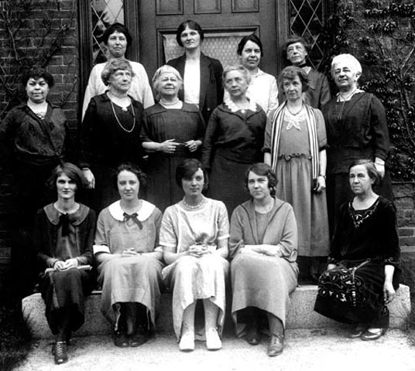
Harvard College Observatory
Between 1875 and 1920, 164 women worked at various U.S. observatories. Over ¼ of them at Harvard College Observatory.
They were usually paid between 25¢ and 35¢ per hour, and were rarely allowed to do independent research projects.

